Slide 1
HUMAN RESOURCE DEVELOPMENT
UNIT-3 PART-I

Slide 2
JOB ANALYSIS
Job analysis is a systematic way to gather and analyze information about the content and the human requirements of jobs and the context in which jobs are performed.
Dale Yoder (1983) defines job analysis as “a process in which jobs are studied to determine what tasks and responsibilities they include, their relationships to other jobs, the conditions under which work is performed, and the personnel capabilities required for satisfactory performance.”
According to Gary Dessler, “Job analysis is the procedure for determining the duties and skills requirements of a job and the kind of person who should be hired for it.”
According to Edwin B. Flippo, “Job Analysis is the process of studying and collecting information relating to the operation and responsibilities of a specific job.”

Slide 3
This should include the:
Knowledge: Knowledge is the degree to which a job holder must know specific technical material.
Skill: Skill is defined as adequate performance on tasks requiring tools, equipment, and machinery.
Abilities: Abilities refers to the physical and material capabilities needed to perform tasks not requiring the use of tools, equipment, and machinery. Further, where the job is completed must be considered.
Types of information to be collected by a job analysis are shown below:
Work activities.
Work-oriented activities.
Machines, tools, equipment, and work aids are used.
Job-related tangible and intangible.
Work performance.
Job context.
Personal requirement.

Slide 4
TERMINOLOGY USED IN JOB ANALYSIS
Task: An identifiable work activity carried out for a specific purpose. For example, typing a letter.
Duty: Several tasks that are related to some sequence of events. For example, pick up, sort out, and deliver incoming mail.
Position: A collection of tasks and duties which are performed by one person. For example, the P.A. to Chairman receives visitors, takes dictation, operates the computer, answers queries, attends to complaints, and helps students.
Job: A group of positions similar in their significant duties. For example, the job of salesmen, technical assistants, computer programmers, etc.
Job Families: Groups of different jobs that need similar skills. For example, sales jobs and clerical jobs in different departments.
Job Code: A job code uses numbers, letters, or both to provide a quick summary of a job and its content.
Job Classification: The grouping of jobs on some basis, such as the nature of work done or the level of pay. For example, skilled, semiskilled, and unskilled Grade II and III officers in a Bank.

Slide 5
TERMINOLOGY USED IN JOB ANALYSIS
Job Analysis: The process of gathering information about a job.
Job Description: A written summary of tasks, duties, and responsibilities of a job.
Job Specification: The minimum skills, education, and experience necessary for an individual to do a job.
Job Evaluation: A systematic procedure for finding the relative worth of a job.
Job Sharing: It is a scheduling innovation that allows two or more workers to share a job.
Job Design: A conscious effort to organize tasks, duties, and responsibilities into a unit of work to achieve a certain objective.
Job Rotation: Moving employees horizontally or vertically to expand their skills, knowledge, or activities.
Job Enrichment: Adding more responsibilities, autonomy, and control to a job.

Slide 6
STEPS IN JOB ANALYSIS
Determine the purpose of the job analysis.
Identify the jobs to be analyzed.
Determine the data collection method.
Explain the process to employees & involve them.
Collect job analysis information.
Process the job analysis information.
Review & update frequently.

Slide 7
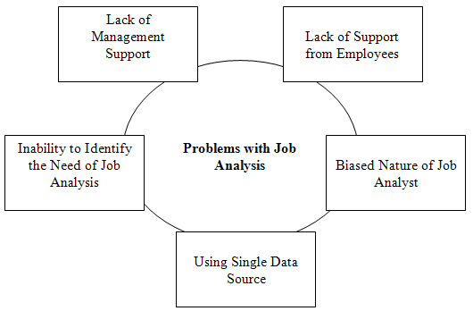
PROBLEMS WITH JOB ANALYSIS

Slide 8
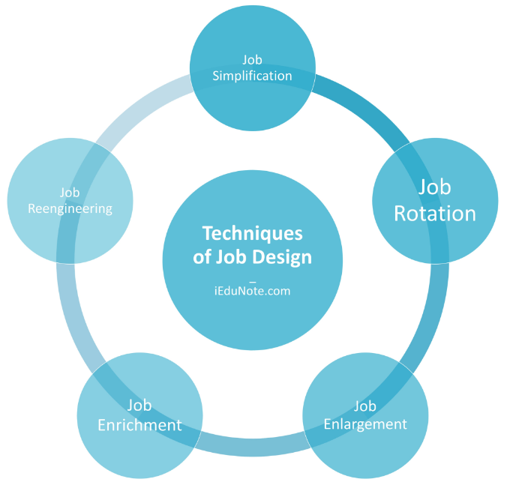
JOB DESIGN
Job design is a continuous, systematic process of organizing job-related tasks, responsibilities, functions, and duties.
It integrates content related to a job to achieve specific objectives. The process plays a vital role as it affects the productivity of employees and organizations.
Job design is the next step after job analysis that outlines and organizes tasks and responsibilities associated with a specific job. Job design integrates job responsibilities and qualifications or skills required to perform the same.

Slide 9
JOB DESIGN HELPS TO DETERMINE:
what tasks are done,
how the tasks are done,
how many tasks are done, and
in what order the tasks are done.

Slide 10
FEATURES OF A GOOD JOB DESIGN
Variety and challenge
Completeness of task
Autonomy and feedback
Skill development
Meaning and purpose

Slide 11
Organizational Factors
Task Features
Work Flow
Ergonomics
Work Practices
Environmental Factors
Technology
Legislation
Behavioral Factors
Competition
Employee Skills & Abilities
Employee Availability
Social & Cultural Expectations
FACTORS AFFECTING
JOB
DESIGN

Slide 12
JOB SIMPLIFICATION
In layman’s terms, job simplification involves breaking down a complex task into several simpler parts.
Frederick Taylor was the first to endorse this approach. He proposed breaking down complex tasks into simple components, which are simple to learn and implement. The benefit is that a low skill level is required, it is less expensive for the organization, plus less error expectancy due to specialization.
Jobs are simplified or specialized here. A specific job is split up into small parts, with each piece assigned to a different person.
Job simplification entails:
Work mechanical processing
Repeating work operations
Working on one part of the production
Early identification of tools and skills
Few skills required

Slide 13
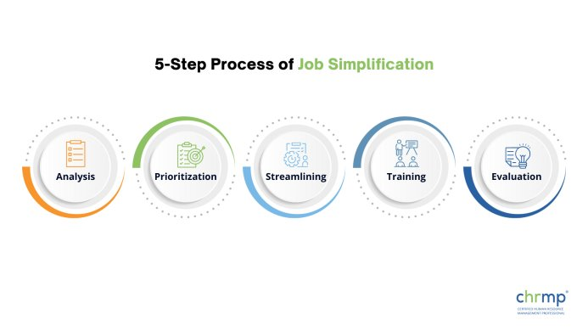

Slide 14
IMPORTANCE OF JOB SIMPLIFICATION

Slide 17
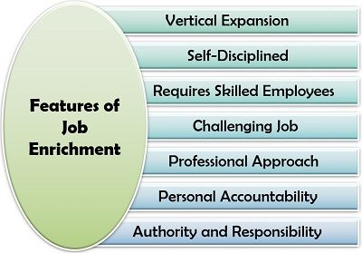
JOB ENRICHMENT
Job enrichment is a strategy used to motivate employees by giving them increased responsibility and variety in their jobs.

Slide 18
JOB ENRICHMENT THEORY (HERZBERG'S TWO FACTOR THEORY)
The concept of job enrichment was developed by the American psychologist Frederick Herzberg in the 1950s. The two-factor motivation theory, otherwise known as Herzberg’s motivation-hygiene theory or dual-factor theory, argues that there are separate sets of mutually exclusive factors in the workplace that either cause job satisfaction or dissatisfaction.
Generally, these factors encouraging job satisfaction relate to self-growth and self-actualization.
The two-factor motivation theory has become one of the most commonly used theoretical frameworks in job satisfaction research.
To Herzberg, motivators ensured job satisfaction, while a lack of hygiene factors spawned job dissatisfaction.
These so-called “satisfiers” (motivational factors) and “dissatisfiers” (a lack of hygiene factors) are dynamic, constantly interacting, highly subject to change, and relative to the employee. Certain satisfiers or dissatisfiers may be more important than others depending on personal and professional contexts

Slide 19
HERZBERG’S HYGIENE FACTORS
Hygiene factors are those which decrease job dissatisfaction. Herzberg, Mausner, and Snyderman used the term hygiene as “medical hygiene…[which] operates to remove health hazards from the environment”.
Herzberg also states that hygiene factors are extrinsic to the job and function in “the need to avoid unpleasantness” (Herzberg, 1966).
Interpersonal relations: Interpersonal relationships involve the personal and working relationships between an employee and his supervisors, subordinates, and peers.
Salary: Salary includes wage or salary increases and negative unfulfilled expectations of wage or salary increases.
Company policies and administration: Company policies and administration include factors such as the extent to which company organization and management policies and guidelines are clear or unclear.
Supervision: Supervision involves an employee’s judgments of the competence or incompetence and fairness or unfairness of the supervisor or supervision.
Working conditions: Finally, working conditions involve the physical surroundings of the job and whether or not they are good or poor.
Factors leading to a good or poor workspace could involve the amount of work, space, ventilation, tools, temperature, and safety.

Slide 20
^{MOTIVATION FACTORS}
According to Herzberg, these motivators are intrinsic to the job and lead to job satisfaction because they satisfy the needs for growth and self-actualization (Herzberg, 1966).
Advancement: Herzberg defined advancement as the upward and positive status or position of someone in a workplace. Meanwhile, a negative or neutral status at work represents negative advancement.
The work itself: The content of job tasks can positively or negatively affect employees.
Possibility for growth: Possibilities for growth exist in the same vein as Maslow’s self-actualization; they are opportunities for a person to experience personal growth and promotion in the workplace.
Responsibility: Responsibility encompasses both the responsibilities held by the individual and the authority granted to the individual in their role.
Recognition: When employees receive praise or rewards for reaching goals or producing high-quality work, they receive recognition. Negative recognition involves criticism or blame for a poorly done job.
Achievement: Positive achievement can involve, for example, completing a difficult task on time, solving a job-related problem, or seeing positive results from one’s work. Negative achievement includes failure to progress at work or poor job-related decision-making.

Slide 21
BENEFITS OF JOB ENRICHMENT
Job enrichment and job satisfaction
Decreased employee turnover
Reduced absenteeism
Job enrichment and communication
Succession planning
Job enrichment and productivity
Job enrichment and productivity
Job enrichment and productivity

Slide 23
PRINCIPLES OF JOB ENRICHMENT INCLUDE
Creating meaningful roles through feedback, encouragement, communication, and autonomy.
Expanding the scope of a job description with a greater variety of tasks, vertical in nature, that requires self-sufficiency.
Focusing on creating jobs with meaning.
Improving employee relations, attracting and retaining quality employees, reducing absenteeism, improving quality and productivity, and increasing return on investment.
Many job enrichment programmes are based on the Hackman & Oldham model (1974), which outlines five core job dimensions that affect job satisfaction: Autonomy, Skill variety, Task identity, Task significance, and Feedback.

Slide 24
STRATEGIES OF JOB ENRICHMENT
Feedback
Rotate jobs
Autonomy
Automation
Project
Share employee feedback
Surveying
Communication
Suggestion programs
Incentive programs
Increased responsibility
Job crafting
Job Diagnostic Survey
Motivating
Learning
Personal accountability
Quality circles
Resource management

Slide 25
5 CORE DIMENSIONS OF J.E.
1. Task Variety
2. Task Identity
3. Task Significance
4. Autonomy
5. Feedback

Slide 26
HURDLES IN JOB ENRICHMENT
Increases workload
Additional skills needed
Lack of knowledge
Incapability
Mis-communication
Lack of performance
Unfavorable for the employees

Slide 28
JOB ENLARGEMENT
Job enlargement is all about adding additional responsibilities to a role within the same level.
For example, an employee might take on more planning activities within their role, rather than assigning these tasks to their manager. Think of it as a form of vertical job expansion. The idea is that, with added responsibilities and challenges, there’s less time for employees to be bored.

Slide 29
JOB ENLARGEMENT
ADDING TASK
COMBINING TASK
MULTI-SKILLING
Example of Job Enlargement
A marketing coordinator works for a company and is responsible for managing the company’s social media accounts, creating email campaigns, and coordinating events. The company decides to enlarge their job to provide the marketing coordinator with more challenging and fulfilling work.
The company adds the additional responsibilities of creating and implementing a content marketing strategy, conducting market research, and managing the company’s website. The marketing coordinator is also responsible for creating and managing paid advertising campaigns.

Slide 30
JOB ROTATION
Job rotation is a human resources management practice where employees are moved between different roles or departments within an organisation or its subsidiaries for a specified period.
Skill development
Employee engagement and motivation
Succession planning and talent development
Knowledge transfer and cross-training
Enhanced organizational flexibility and adaptability
OBJECTIVES

Slide 31
TYPES OF JOB ROTATION PROCESSES
Horizontal Job Rotation
Vertical Job Rotation
Departmental Job Rotation
Geographic Job Rotation
Time-Based Job Rotation
Project-Based Job Rotation

Slide 32
IMPLEMENTATION OF JOB ROTATION
Identify Objectives
Assess Organizational Readiness
Define Job Roles and Responsibilities
Identify Potential Rotation Opportunities
Develop Rotation Plans
Communicate and Gain Buy-In
Provide Training and Support

